Slide 1
Ethics in Robotics and HRI
Based in part on the presentation
“Socially-responsible research in Cognitive Systems: No-win or win-win?”
Tony Prescott, University of Sheffield
EUCog Meeting
Brighton, UK 2013

Slide 2
Overview
The evolving ethical landscape of European science
Applying ethics in Cognitive Systems research
An example domain “Robots in Care”
Human-robot interaction

Slide 3
Ethics
Philosophy of morality
Impacts
Law
Public policy
Commerce
Research
Personal choice

Slide 4
Ethics and Robotics
Popular perception focuses on
Autonomy
Applications
Similar issues to many computer technologies
Privacy, security, etc
Unique due to physical abilities of robots

Slide 5
Threat of AI
Stephen Hawking interview
Long term consequences
Distant future (?)
Abstract

Slide 6
Credible Threat?
Near-term robotics
Not fully autonomous
Act in restricted domains
Danger from limitations, not capabilities
Risk of misrepresenting research
Overselling results
Public misperceptions

Slide 7
What’s on the Horizon?
Autonomous, potentially self-aware, control systems running critical infrastructure
Driverless vehicles
Robotic surgery
Robots in personal care
Cognitive enhancements
More connected, better memory, support decision making
Smart prostheses

Slide 8
Case Studies
Robotic technologies already available and used
Low-cost, non-autonomous robots
In public spaces
In homes
Internet not only for computers
Data collection
Privacy
Security

Slide 9

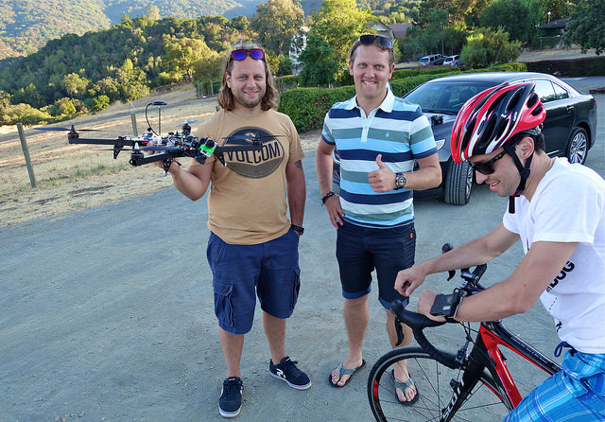
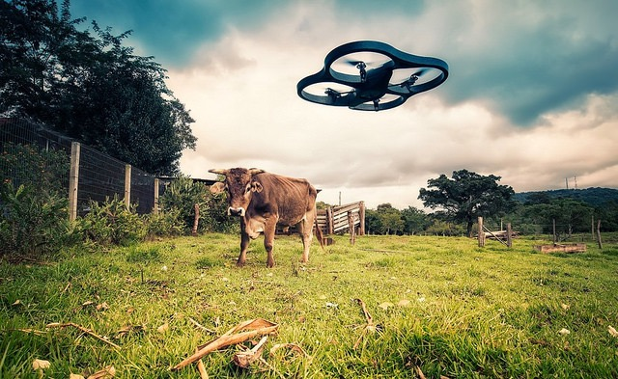
Drones
Government use
Commercial use
Personal use

Slide 10
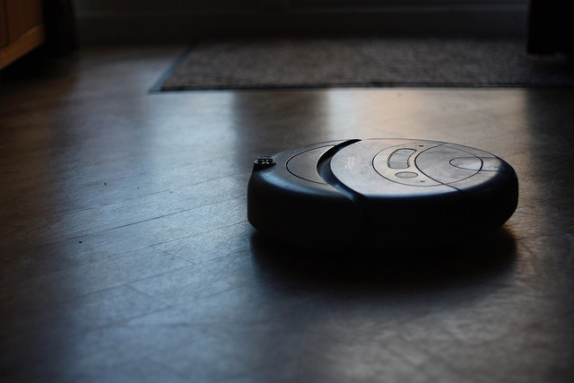
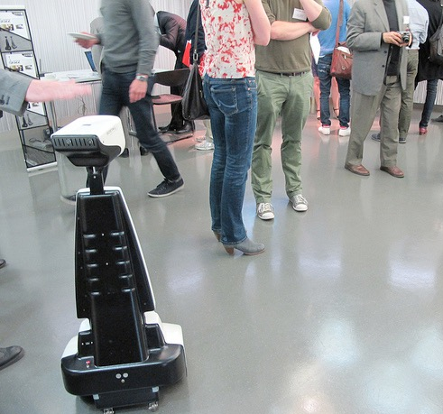
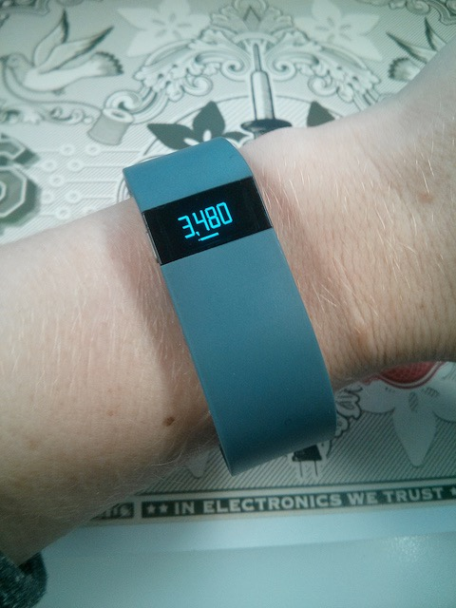
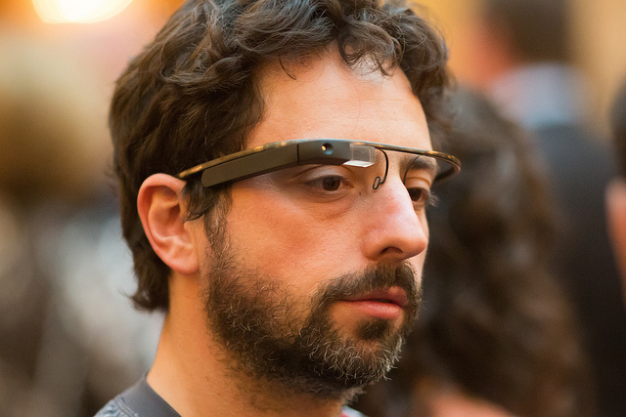
Telepresence and Ambient Intelligence
Internet of things
Telepresence robots
Wearable sensors
Google glass

Slide 11
Ethics in Science: Traditional View
Science performed well is intrinsically neutral and good
Ethics is compliance with codes and regulations + expert advice
Undesirable impacts of science are addressed by corrective action as and when they occur
Notes:
Neutral: Just telling the truth about the world as it is
Good: More knowledge is more power to control Nature, and that is always good
Ethics: Master the craft, stay truthful, critical and objective

Slide 12
Ethics in Science: Contemporary View
Science is not isolated from society and politics
Ethical science requires the early anticipation and characterisation of risk and could lead to decisions not to pursue some lines of research
Ethics involves the need for public dialogue, broader than user involvement
Integrating ethics into science requires that critical, skeptical and even dissenting voices are attended to at all stages

Slide 13
The Changing Nature of Science
Mode 1: Science as discovery
Separate enterprise pursued for own ends
Clear disciplinary boundaries
Scientists and their host institutions (universities) are autonomous entities
Mode 2: Science as knowledge production
Socially-distributed enterprise pursued for diverse motivations that can include commercial interest
Application-oriented
Trans-disciplinary
Scientists are subject to many accountabilities
Gibbons Michael, Limoges Camille, Nowotny Helga, Schwartzman Simon,
Scott Peter and Trow Martin (1994) The New Production of Knowledge.
Notes:
research communities now have open frontiers which has allowed many new kinds of ‘knowledge’ organisation - such as think-tanks, management consultants, activist groups - to join the research game.
‘pure’ science, generated in theoretical / experimental environments, is ‘applied; technology is ‘transferred’; and knowledge is subsequently ‘managed’. The context of application, in contrast, describes the total environment in which scientific problems arise, methodologies are developed, outcomes are disseminated and uses are defined.
The second characteristic is trans-disciplinarity, by which we mean the mobilisation of a range of theoretical perspectives and practical methodologies to solve problems. Teams
are brought together and dissolve upon having finished their work, only to be re-configured in a different constellation for another task.

Slide 14
Recognisable Trends
`Steering’ of research priorities (international, national and institutional)
Increased linking of science with innovation
Commercialisation of research (e.g. of intellectual property)
Accountability of science (e.g. auditing)

Slide 15
Science and the Public
The public do not see science as “neutral”
A mix of positive and negative
Different attitudes towards different fields
Concerned about risk
Don’t have the same view on risk as experts
Need for open communication
Scientists must be ready to address concerns about how research is applied

Slide 16

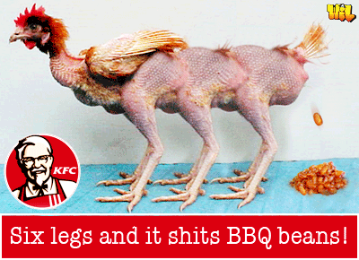
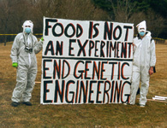
The Risks of Getting in Wrong
Technologies arising from Cognitive Systems research are potentially more controversial than GM.

Slide 17
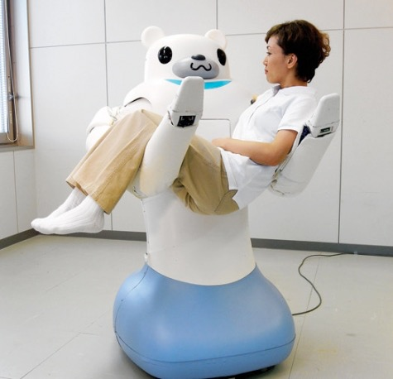
Example domain:
The risks and benefits of using robots in care
Prescott (2013), Sunny uplands or slippery slopes? The risks and benefits of using robots in care, UKRE Workshop on Robot Ethics, 25th March 2013, Sheffield, UK.
http://tinyurl.com/robotisincare

Slide 18
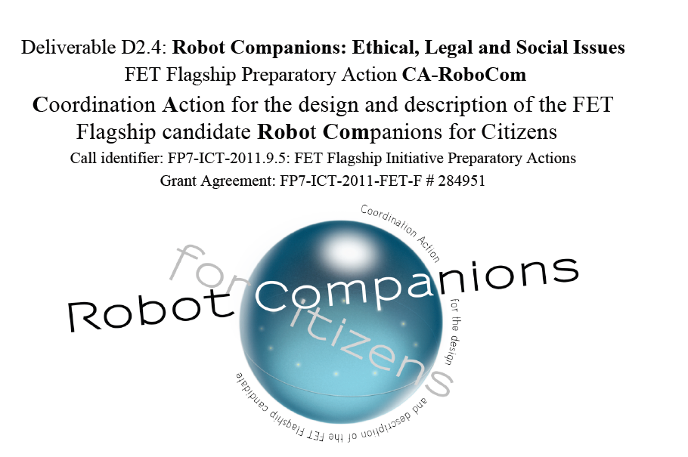
EU Research on Social Implications
http://tinyurl.com/rccels
Prescott, Evers, Epton, McKee, Hawley, Webb, Benyon, Conran, Strand, Nourbakhsh, de Cock Buning, Verschure, Dario (2012), Robot Companions: Ethical, Legal and Social Issues (CA-Robocom D2.4).

Slide 19
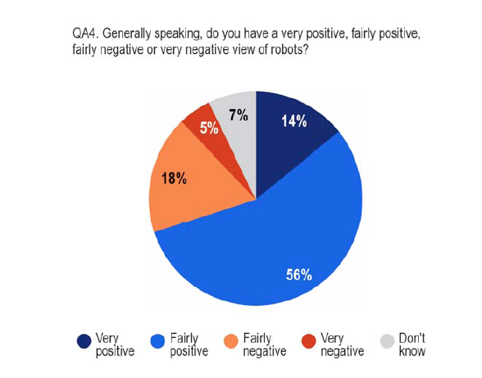
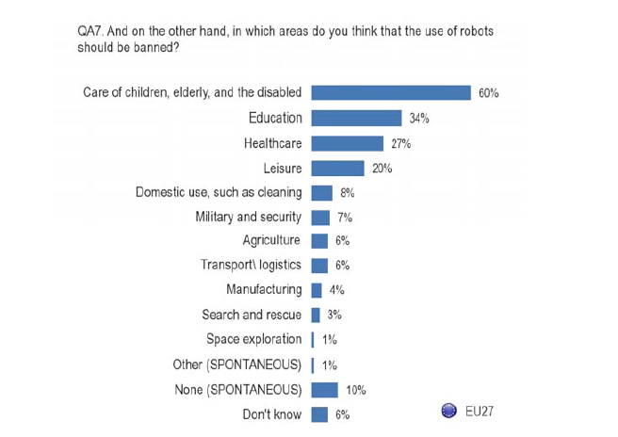

Public Attitudes
EU Barometer Survey 382, March 2012
27 EU countries, 26,751 respondents

Slide 20
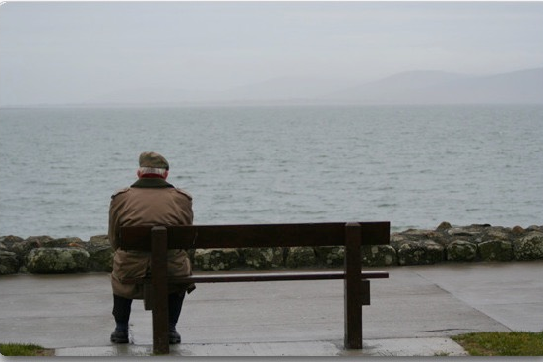
Robots and social isolation
“It is likely that success in introducing robots into the aged-care sector will be at the expense of the amount of human engagement available to frail aged persons. [...] It is our view that handing over cleaning and other household tasks to Robocare, Rosie, Yumel, Wakamaru, or Mentorbot—or their equivalent—would therefore most likely be detrimental to the well-being of frail older people.” (Sparrow and Sparrow, “In the hands of machines? The future of aged care”, Minds and Machines 2006)

Slide 21
Dystopias, utopias & plausible futures
Imagineable Outcomes
Dystopian
Utopian
Harmful
Likely
Beneficial
Notes:
A general strategy for robot ethics pictured as a Venn diagram. Consider the space of imagineable outcomes which includes some that are beneficial to human welfare (B) and others that are harmful (~B). Some of these outcomes are likely (L), others unlikely (~L). (I picture these as binary classes though clearly both classifications could be graded.) This simple scheme leads to four categories of outcomes.
~L&~B: these are dystopian visions of future worlds that are highly unlikely even though they are imagineable. The role of the ethicist is to analyse these outcomes, assess what steps would be needed for them to arise, and explain to people why these scenarios are unlikely to play out.
~L&B: At the opposite extreme these are unlikely utopian visions they may be promoted by the over-enthusiastic. Again the role of ethicist is analyse and caution against exaggerated claims.
L&~B: These are harmful outcomes that could happen. Having established the plausibility of such scenarios we should be proactive in developing strategies to avoid them.
L&B: These are beneficial outcomes that could happen. Having established their plausibility we should actively develop strategies to promote them.
The figure also illustrates a slippery slope where what we thought was an L&B outcome proves to be the start of a slide into the harmful category. Slippery slopes deserve to be analysed and we should develop safeguards (§) against those that have a convincing warrant. We should also balance our assessment of the benefits of L&B against the risk, that despite our best effort, we might find ourselves on a slippery slope leading to L&~B. Applied to robot care, I consider that “the eldercare factory” and “total [robot] child-care” worst-case outcomes, although imagineable, belong to ~L~B category, for the reasons outlined in this paper.

Slide 22
Slippery slopes
Dystopian
A slippery
slope
Utopian
Harmful
Beneficial
Notes:
The figure illustrates a general strategy for robot ethics that can be applied to case of robot care. I picture the space of all possible imagineable outcomes which includes some that are beneficial to human welfare (b) and some that are harmful (~b). Some of these outcomes are likely or plausible (p), some or unlikely or implausible (~p). I picture this as a binary classification here, though obviously we might think of it more as a gradient. This scheme gives rise to four categories of outcomes:
~l~b: These are dystopian visions of future worlds that are highly unlikely even though they are imagineable. The role of the ethicist is to analyse the outcomes, assess what steps would be need for them to arise, and explain to people why these scenarios are unlikely to play out.
~LB: At the opposite extreme these are utopian visions they may be promoted by the over-enthusiastic. Again the role of ethicist is analyse and caution against exaggerated claims.
L&~B: These are harmful outcomes that could happen. Having established the plausibility of such scenarios we should be proactive in developing safeguards against them.
L&B: These beneficial outcomes that could happen. Having established their plausibility we should develop strategies to promote them.
The figure also illustrates a slippery slope where an L&B outcome turns out to be the first step towards disaster, the slippery slope leads initially via a plausible but harmful outcome we had hoped to avoid to a worst case outcome that mght have initially seemed implausible. Slippery slopes deserve to be analyse, but we need to carefully examine their plausibility

Slide 23
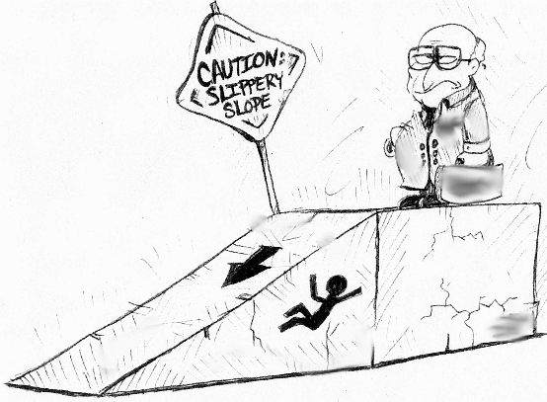
Slippery slope logic
An action that by itself seems harmless, establishes a trajectory that, with high probability, leads to an unintended and unethical final outcome
Example: Introducing robots for help in the care of older people has the knock-on effect of reducing contact with other people, ultimately leading to older people being left “in the hands of machines”.

Slide 24
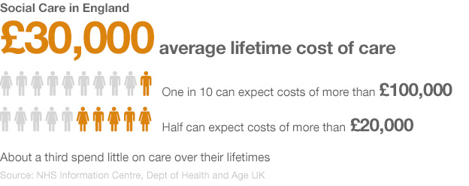
The slippery slope of robot care?
“Even if robots were to become capable of filling some service roles in the aged-care sector, economic pressures on the sector would most likely ensure that the result was a decrease in the amount of human contact experienced by older persons being cared for, which itself would be detrimental to their well-being”
(Sparrow and Sparrow, 2006)
Notes:
£21B

Slide 25
What is required for this to come about?
(i) Robots will need to be sufficiently autonomous as to not require the supervision of human care staff
(ii) The use of robots will not lead to more effective deployment of human care that compensates any reduction in the number of human carers.
(iii) Older people themselves will take no significant action to compensate for any loss in social contact due to the introduction of care robots.
(iv) Governments, companies, charities, and other bodies responsible for social care of older people, will consider that human-human contact is sufficiently unimportant that older people can be left increasingly in the care of robots.

Slide 26
Robot autonomy
Robots will need to be sufficiently autonomous as to not require the supervision of human care staff
It is unlikely, in the foreseeable future, that robots will be sufficiently autonomous to provide care unaided. It is more likely that care will be provided by robot-human teams

Slide 27
Robots and human-human care
(ii) The use of robots will not lead to more effective deployment of human care that compensates any reduction in the number of human carers
Caring roles could become more professional, carers could have more time not less for human-human contact; decoupling physical care from social care can allow the latter to be provided where it is most effective

Slide 28
Older people can adapt
(iii) Older people themselves will take no significant action to compensate for any loss in social contact due to the introduction of care robots.
At a time when we are expecting increasing numbers of older people, who will stay active longer, and who will be better connected through use of ICT technologies, it seems paradoxical that they will not respond to changes in the nature of care, such as the introduction of robots, by taking actions themselves to help meet their social needs

Slide 29

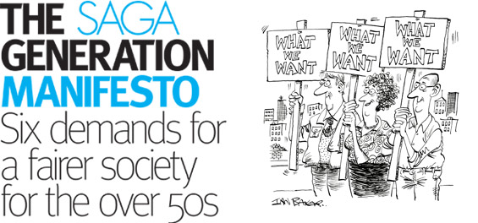
Societal inaction
(iv) Governments, companies, charities, and other bodies responsible for social care of older people, will consider that human-human contact is sufficiently unimportant that older people can be left increasingly in the care of robots.
Developed countries will have a much higher percentage of older people than they do now. Older people, as a constituency, already have significant political power, and the demographic shift will only give them a stronger voice

Slide 30
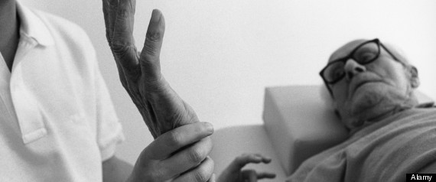
Getting the balance right
If, as the Eurobarometer survey suggests, people are already turning against the possibility of robot carers, even before they exist in any real way, then this is a significant worry—the costs of not developing these technologies to future human welfare, might actually outweigh the risks

Slide 31
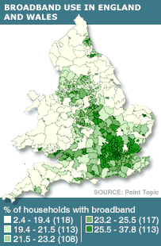
The robot divide?
A risk we should consider is that, like the digital divide, robots for care will only be available for the better-off in our societies

Slide 32
Getting the balance right
What is the cost of not doing this?
Dystopian
Utopian
Harmful
Beneficial
How does this balance against the risk of ending up here?
Notes:
The figure illustrates a general strategy for robot ethics that can be applied to case of robot care. I picture the space of all possible imagineable outcomes which includes some that are beneficial to human welfare (b) and some that are harmful (~b). Some of these outcomes are likely or plausible (p), some or unlikely or implausible (~p). I picture this as a binary classification here, though obviously we might think of it more as a gradient. This scheme gives rise to four categories of outcomes:
~l~b: These are dystopian visions of future worlds that are highly unlikely even though they are imagineable. The role of the ethicist is to analyse the outcomes, assess what steps would be need for them to arise, and explain to people why these scenarios are unlikely to play out.
~LB: At the opposite extreme these are utopian visions they may be promoted by the over-enthusiastic. Again the role of ethicist is analyse and caution against exaggerated claims.
L&~B: These are harmful outcomes that could happen. Having established the plausibility of such scenarios we should be proactive in developing safeguards against them.
L&B: These beneficial outcomes that could happen. Having established their plausibility we should develop strategies to promote them.
The figure also illustrates a slippery slope where an L&B outcome turns out to be the first step towards disaster, the slippery slope leads initially via a plausible but harmful outcome we had hoped to avoid to a worst case outcome that mght have initially seemed implausible. Slippery slopes deserve to be analyse, but we need to carefully examine their plausibility

Slide 33
A Role for Researchers?
Imagineable Outcomes
Help analyse and explain why this is unlikely
Dystopian
Utopian
Harmful
Likely
Beneficial
Help identify and develop strategies to avoid this
Help identify and develop strategies to promote this
Notes:
A general strategy for robot ethics pictured as a Venn diagram. Consider the space of imagineable outcomes which includes some that are beneficial to human welfare (B) and others that are harmful (~B). Some of these outcomes are likely (L), others unlikely (~L). (I picture these as binary classes though clearly both classifications could be graded.) This simple scheme leads to four categories of outcomes.
~L&~B: these are dystopian visions of future worlds that are highly unlikely even though they are imagineable. The role of the ethicist is to analyse these outcomes, assess what steps would be needed for them to arise, and explain to people why these scenarios are unlikely to play out.
~L&B: At the opposite extreme these are unlikely utopian visions they may be promoted by the over-enthusiastic. Again the role of ethicist is analyse and caution against exaggerated claims.
L&~B: These are harmful outcomes that could happen. Having established the plausibility of such scenarios we should be proactive in developing strategies to avoid them.
L&B: These are beneficial outcomes that could happen. Having established their plausibility we should actively develop strategies to promote them.
The figure also illustrates a slippery slope where what we thought was an L&B outcome proves to be the start of a slide into the harmful category. Slippery slopes deserve to be analysed and we should develop safeguards (§) against those that have a convincing warrant. We should also balance our assessment of the benefits of L&B against the risk, that despite our best effort, we might find ourselves on a slippery slope leading to L&~B. Applied to robot care, I consider that “the eldercare factory” and “total [robot] child-care” worst-case outcomes, although imagineable, belong to ~L~B category, for the reasons outlined in this paper.

Slide 34
Robots can help carers
Robots can
Help address the shortage of skilled labour in the caring professions
Assist carers to be more efficient
Help older people assist each other
Allow carers to focus more on the human-to-human aspects of their work, creating a more skilled profession and making care-work more rewarding
Relieve some of the injuries that happen to carers through the physical aspects of their work
The introduction of robots will not solve all societal problems raised by the demographic shift, which must also be addressed through wider political and social actions, but they can provide part of the solution
Notes:
indicates that every year 800,000 UK
nurses injure their backs while working, at a cost of £400M per annum, with many also retiring early as a result.
EHRC (2011). Close to home: An inquiry into older people and human rights in
home care. http://www.equalityhumanrights.com/
Dhner, H., Ldecke, D., Eickho, V. (2008). Migrant workers in home care for older
people in Germany: Use and problems of legal and irregular care. GeroBilim, 01/08.
The introduction of robots will not solve all societal problems raised by the demographic shift, which must also be addressed through wider political and social actions.

Slide 35
Ethics: Conclusion
Ethics is about understanding risk in science and dealing with its implications
Ethics in robotics research should not be left to expert “ethicists”. Multiple sectors of society must engage in the debate, including researchers themselves
Scientists will be held accountable for the results of their research
If robotics researchers engage-in/lead the debate this can lead to better research whose consequences are to benefit of everyone

Slide 36
Human Robot Interaction
Study of robots and people performing tasks together
Measure people’s impressions and attitudes towards robots
Make robots that people find easy and enjoyable to use
Make models of human behavior that robots can use to interact effectively

Slide 37
Related Fields
Robotics
Artificial intelligence
Psychology
Design
Sociology/Ethnography

Slide 38
HRI Application Areas
Education and museum robots
Healthcare and eldercare assistance
Service robots
Urban search and rescue

Slide 39
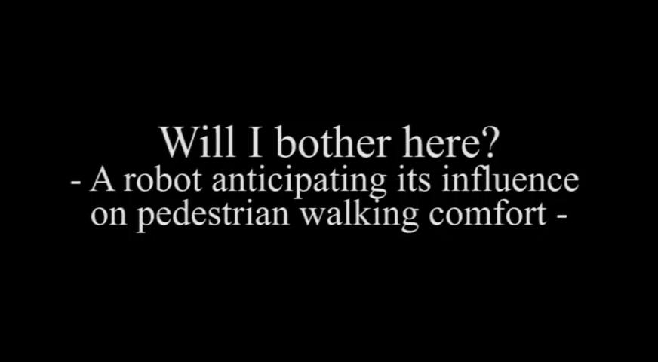
A Recent Example
Will I Bother Here? A Robot Anticipating Its Influence on Pedestrian Walking Comfort Hiroyuki Kidokoro (ATR & Osaka University),Takayuki Kanda (ATR & Osaka University),
Dražen Brščić (ATR), Masahiro Shiomi (ATR)
HRI 2013
Best Paper Award

Slide 40

Anthropomorphism
People attribute intention to things that move on their own
How hard should we try to make a robot like a person?
Heider, Fritz and Simmel, Marianne (1944).
An Experimental Study of Apparent Behavior.
The American Journal of Psychology, 57(2), pp. 243-259.

Slide 41
The Media Equation
“People treat computers like people”
This can also extends to robots... [Ham et al. 2012]
...up to a point [Bartneck and Hu 2008]
Ham, Jaap, Esch, Mirjam van, Limpens, Yvonne, Pee, Jente, Cabibihan, John-John, Ge, ShuzhiSam. “The Automaticity of Social Behavior towards Robots: The Influence of Cognitive Load on Interpersonal Distance to Approachable versus Less Approachable Robots”. Social Robotics, Lecture Notes in Computer Science,V 7621, 2012. pp 15-25.
Byron Reeves & Clifford Nass
The Media Equation: How People Treat
Computers, Television, and New Media like
Real People and Places,
Cambridge University Press: 1996.
Bartneck, C. and Hu, J. (2008) Exploring the abuse of robots. Interaction Studies 9(3): 415-433.

Slide 42
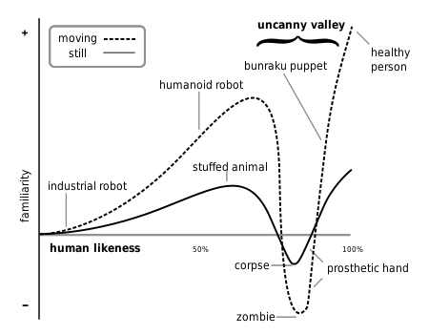
The Uncanny Valley
Mori, M. (1970/2012). The uncanny valley (K. F. MacDorman & N. Kageki, Trans.). IEEE Robotics & Automation Magazine, 19(2), 98–100.

Slide 43
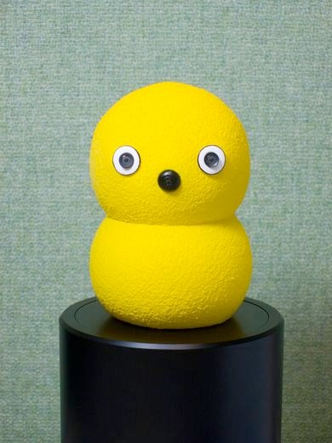
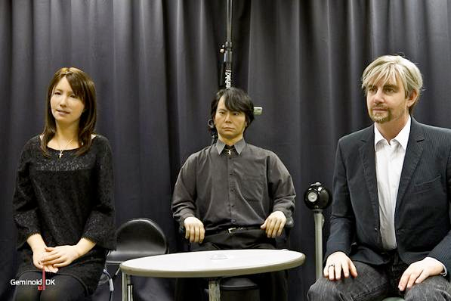
Design Choices
Geminoids
Hiroshi Ishiguro
2005
Keepon
Hideki Kozima
2003

Slide 44
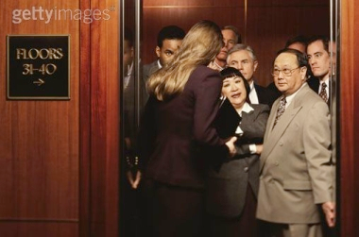
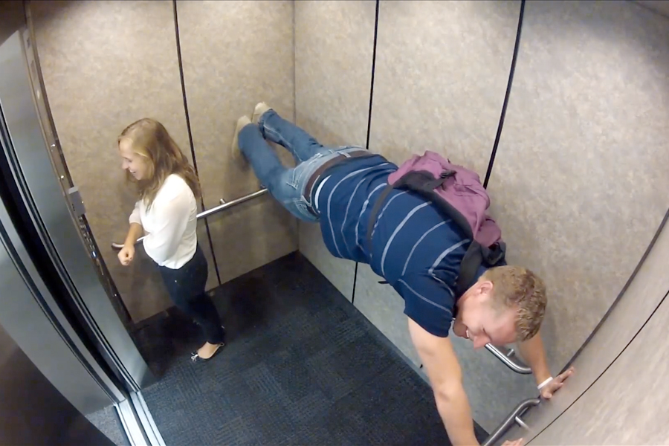
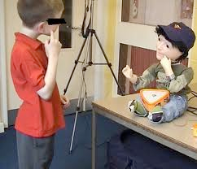
Social Robotics
A robot that interacts with people using social cues and behaviors
Follow human social conventions
Model and predict human behavior
Entertainment
Therapy
Study human social behavior
Right
Wrong
Kaspar
Kerstin Dautenhahn, 2005-2013

Slide 45
Multimodal Communication
“HCI” interaction
Speech
Nonverbal communication
Gesture
Gaze
Proxemics
Emotional expressions

Slide 46
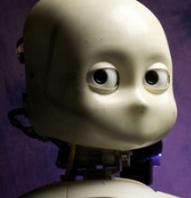
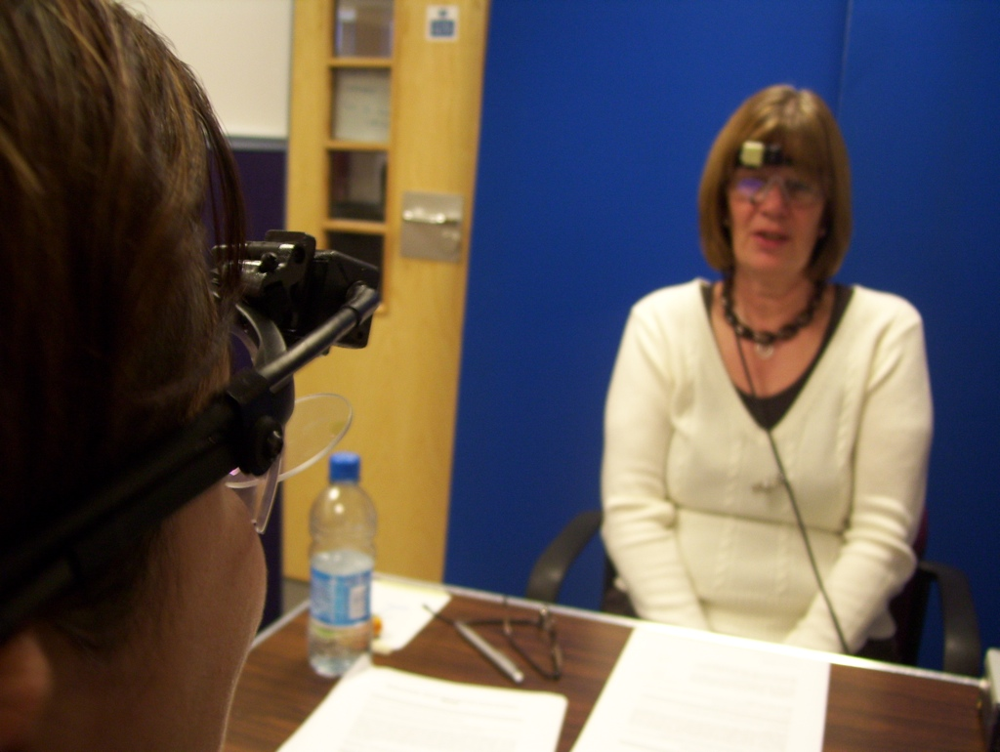
Gaze and Communication
Mutual gaze is critical part of face-to-face interaction [Argyle 1988]
Precursor to, primes for joint attention [Farroni 2003, Saito et. al. 2010]
Communicates social engagement [Cook and Smith 1975], intention [Tomasello et al 2007]
Helps regulate turn-taking [Trevarthan and Aitken 2001, Kleinke 1986]
Absence of meaningful gaze makes it hard to understand cues given by an agent [Garau 2001, Wang and Gratch 2010]
Humans gaze at robot face less than a child’s when interacting (possibly due to unrealistic gaze control) [Vollmer et. al. 2009]

Slide 47
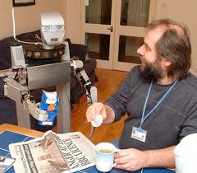
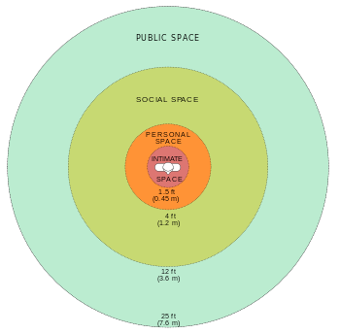
Proxemics
Impact of spatial relationships between agents on interaction [Hall 1963]
Culturally influenced
Distance, angle of robot approach effects human comfort [Dautenhahn et al. 06]
Gender, personality, familiarity with robots [Takayama & Pantofaru 09]

Slide 48
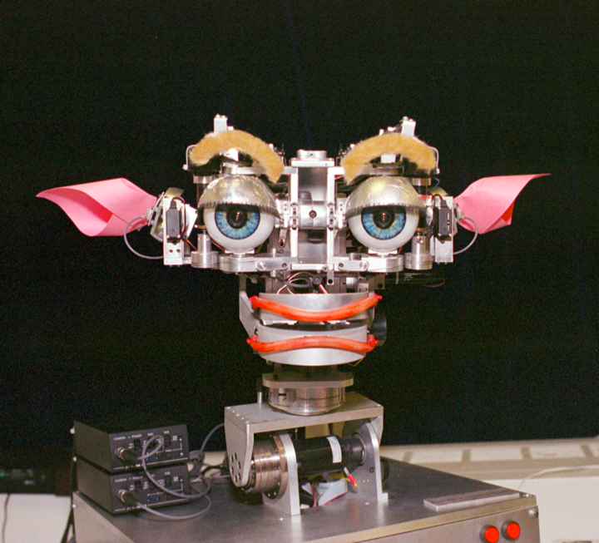
Emotional Expressions
Intuitive way to communicate robot’s internal state to user
Success of expression recognition dependent on embodiment
May include underlying computational model of emotion
Kismet
Cynthia Breazeal, 2000

Slide 49
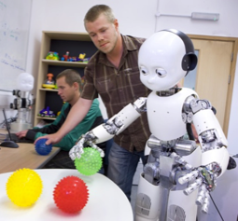
Social Learning
People learn from other people
Can we improve robot learning by making them learn from humans?
Can we improve robot learning by making them learn like humans?
Can humans learn from robots if they work together as peers?
A. Meltzoff, “Like-me: a foundation for social cognition” Developmental Science 10:1, 2007.
Human-Robot Cross-Training: Computational Formulation, Modeling and Evaluation of a Human Team Training Strategy Stefanos Nikolaidis (Massachusetts Institute of Technology) Julie Shah (Massachusetts Institute of Technology)
HRI 2013

